Slide 1


Designing a Streaming Data Pipeline with Dataflow and visualization dashboard using Looker

Slide 2










Trusted Full IT Services Partner since 2010
WHO WE ARE
50+ Clients, 3000+ projects delivered across US, UK, Canada,
Australia, India and ASEAN
550+ career engineers based out of US and India
Centers of Excellence into all Service areas and New Technologies
Mobile Devices and IOT Labs
ISO 27001 and ISO 9001 External surveillance
audit and renewals
CMMi Level 3 – DEV 2.0 Certified
Comply with SOC 2 – Type II
Comply HIPAA regulations
ISO 27001: 2013 | ISO 9001:2015
| CMMi Level 3 certification | SOC2 Certified| HIPAA Certified
24/7 NOC Support
Irving TX, US | Hyderabad, India
MotivityLabs © Copyright 2022. All Rights Reserved.

Slide 3
SERVICES OVERVIEW
PRODUCT ENGINEERING
DEVOPS/CLOUD
ROBOTIC PROCESS AUTOMATION
Custom Application Development
Integration between Applications
Application/ Cloud Migrations
Mobile Application Development
App Support & Maintenance
All Cloud platform support (AWS, Azure, GCP)
Continuous Integration
Continuous Deployment
Continuous Testing
Continuous Monitoring
Continuous Feedback
Kofax
UIPath
Automation Anywhere
Blue Prism
QUALITY ASSURANCE
DATA SCIENCE/ENGINEERING
ENTERPRISE SECURITY
Functional Testing
Compatibility Testing
Localization Testing
Compliance Testing
Test Automation
Web Services/APIs
Load Testing & Capacity Assessment
Predictive Analysis
BI Architecture
R Language
Python
Data Modelling & Warehousing
Data Mining
ETL
Custom Dashboards
Configuration & Migration
Advanced Threat Management
Cyber and Infra Security
Identity and Access Management
Governance, Risk and Compliance
Center of Excellence (CoE): Continuous research, Dedicated labs, Accelerators, Value additions

Slide 4

OUR EXPERTISE
PRODUCT ENGINEERING
PROJECT MANAGEMENT
TOGAF Certified
Full Stack Developers
Cloud Practitioner & Architects
Big Data Platform Architects
PMSPC 5.0
SAFe Agilist
Certified Scrum Master
Lean SixSigma
P, PMI-ACP
DEVOPS/CLOUD
ENTERPRISE SECURITY
AWS Certified Professionals
Azure Certified Professional
MCSE
RHEL
CEH – Certified Ethical Hacker
OSCP – Offensive Security Certified Professional
CISSP - Certified Information Systems Security Professional
AWS – AWS Certified Security
– Specialist
DATA ENGINEERING
Microsoft Certified: Data Analyst
Tableau
Power BI
QUALITY ASSURANCE
ISTQB Certified Engineers
Certified Information Systems Security Professional

Slide 5
Problem Statement
Due to challenges with batch data processing, the organization is having trouble collecting real-time insights. The company consequently plans to build a streaming data pipeline in order to analyze real-time data from their e-commerce website. The streaming data pipeline would ingest, process, and store the data so that it could be utilized to study customer behavior and improve the user experience.

Slide 6




Current as-is Architecture
Website Data Files
Looker Studio
Cloud Storage
Dataflow
Big Query

Slide 7
Our - Solution’s
Creating a streaming data pipeline for a real-time dashboard with Dataflow involves creating a data processing pipeline using Dataflow, applying data transformation logic to the incoming data streams, and monitoring the solution to ensure it is operating effectively and efficiently.
The solution provides businesses with real-time insights, enabling them to make informed decisions quickly. With Dataflow's autoscaling and fault-tolerant capabilities, businesses can handle increasing volumes of data as they grow. Additionally, the solution is cost-effective, as businesses only pay for the resources they use.

Slide 8

Proposed Architecture
Website Data
Looker Studio
PUB/SUB
Dataflow
Big Query

Slide 9
Approach
Setting up of Prerequisites
Create Pub/Sub topic
create a BigQuery dataset and Table
Create a Cloud Storage bucket
Python Code to Publish messages to Pub/Sub topic
Data in Pub/Sub
Set up a Dataflow Pipeline
Analyze the data using BigQuery
Create a real-time dashboard using Looker

Slide 10
Scope
Data Ingestion
Data Processing
Deployment
Monitoring
Data Visualization

Slide 11
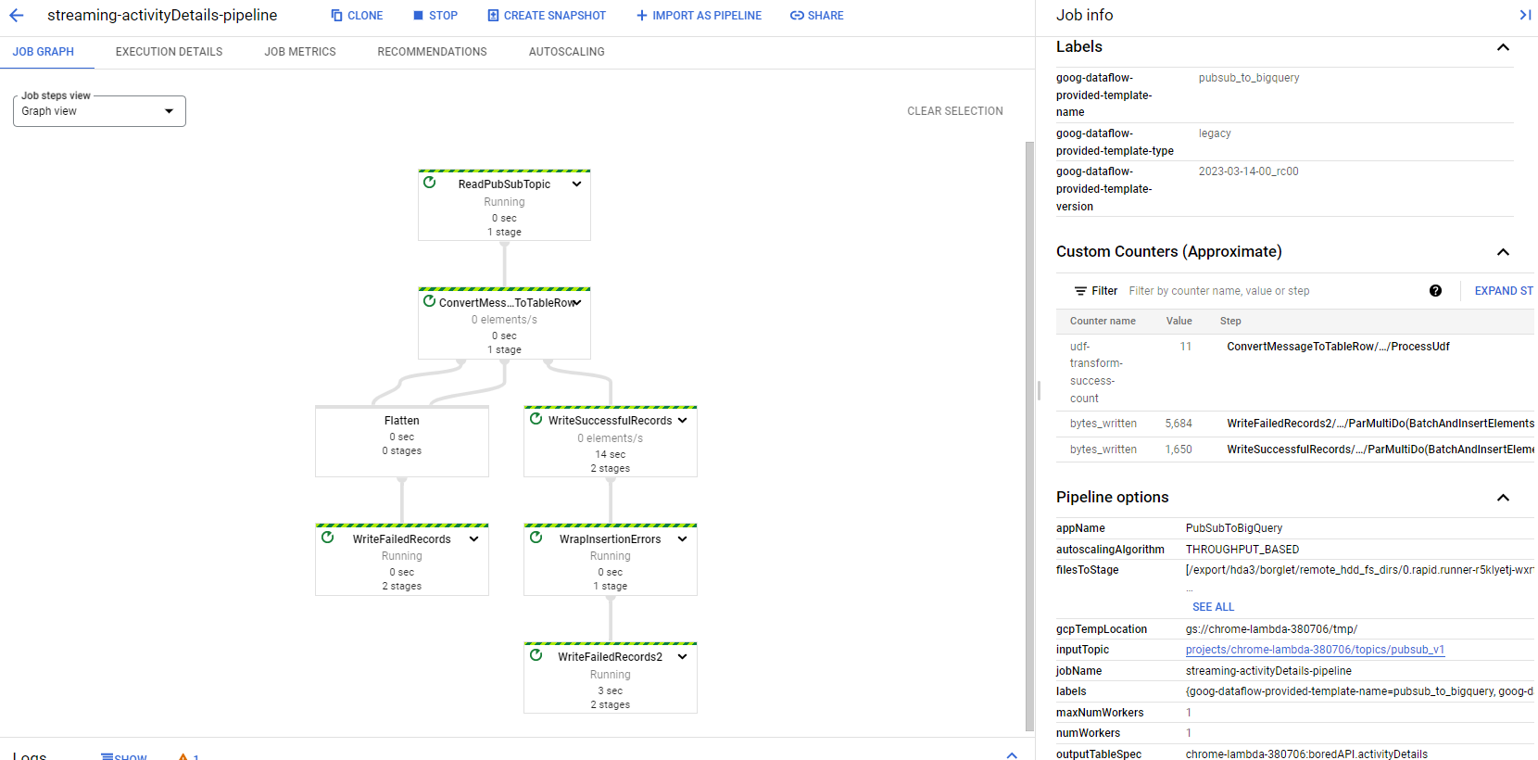
Stream Processing in Dataflow

Slide 12
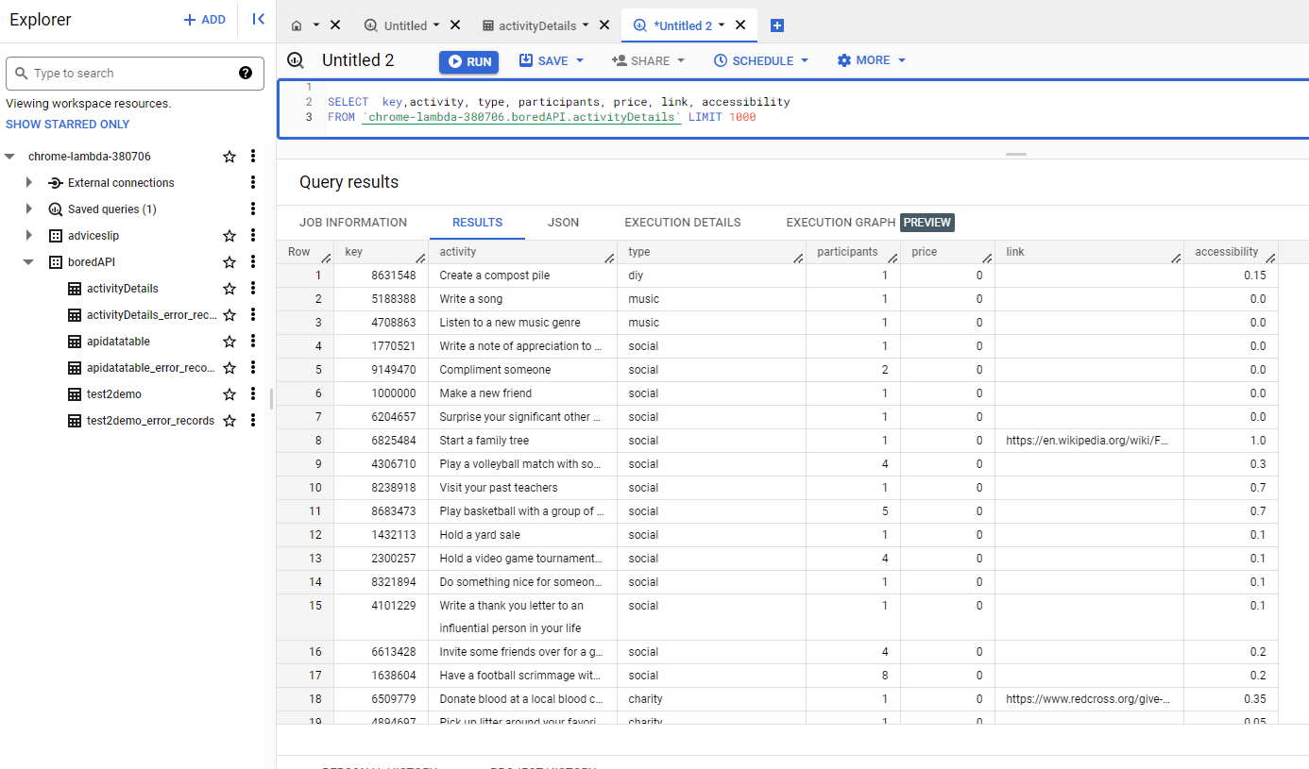
BigQuery Data

Slide 13
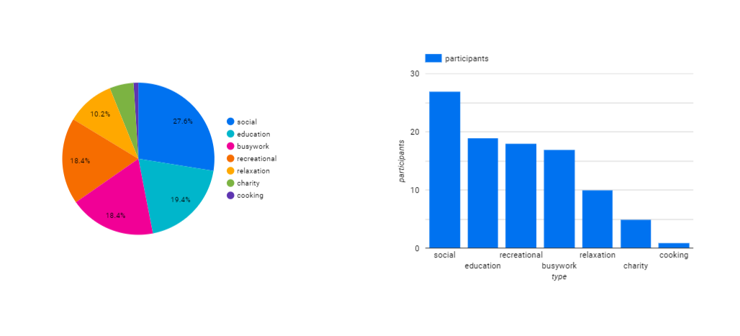
Looker Studio Report

Slide 14
THANK YOU

